Slide 1

STOCK PRICE PREDICTION USING LONG SHORT TERM MEMORY NEURAL NETWORK

Slide 2
Problem Statement
To predict the Stock price of a company on a particular day based on the closing prices of their stock for a period of time.
Dataset
Current Stock Prices of a particular Company for which we need to predict.
Dataset in the from of
( open, high, low, close, volume, %change )
open - stock price at the start of the day.
high - highest recorded price on that day.
low - lowest recorded price on that day.
close - stock price at the end of the day.
volume - total investment on the stock.
%change - percentage change in the stock price wrt the day before.

Slide 3
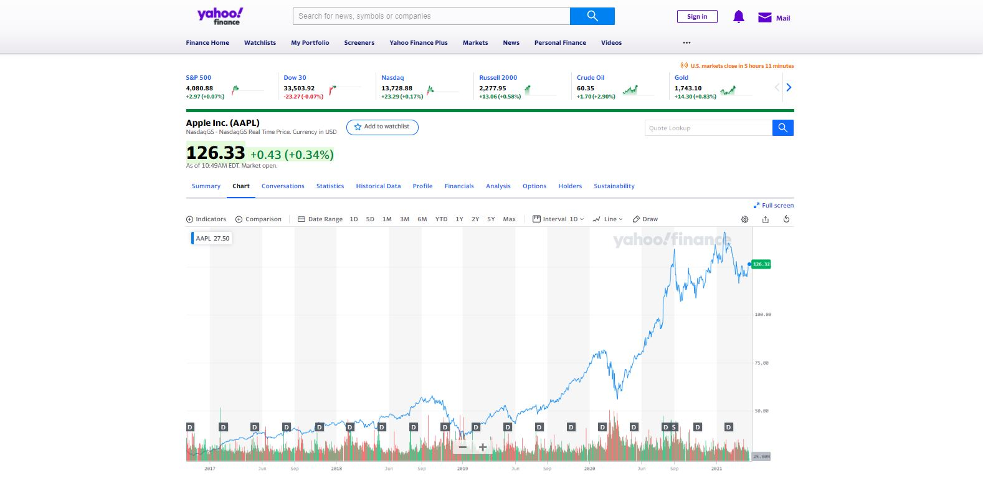
https://finance.yahoo.com/quote/AAPL/

Slide 4
Methodology Used
Linear Regression.
LSTM
Linear Regression
Linear regression is a linear model, e.g. a model that assumes a linear relationship between the input variables (x) and the single output variable (y). More specifically, that y can be calculated from a linear combination of the input variables (x).
LSTM
Long Short-Term Memory (LSTM) networks are a type of recurrent neural network capable of learning Order dependence in sequence prediction problems. This is a behaviour required in complex problem domains like machine translation, speech recognition, and more. LSTMs are a complex area of deep learning

Slide 5
Model Training
Take closing price from the dataset for a period of time and split it into to groups (x , y).
x_train contains a 2D numpy array, each entry contains an array of the last 60 days’ closing prices.
y_train contains every 61’st day’s closing price ( wrt x_train ).
Linear Regression model takes the x-train and y_train and trains the model for RMSE.
LSTM model is mainly composed of 2 LSTM layers ( 50 neurons ) with 2 dense layers to reduce the output to one.

Slide 6
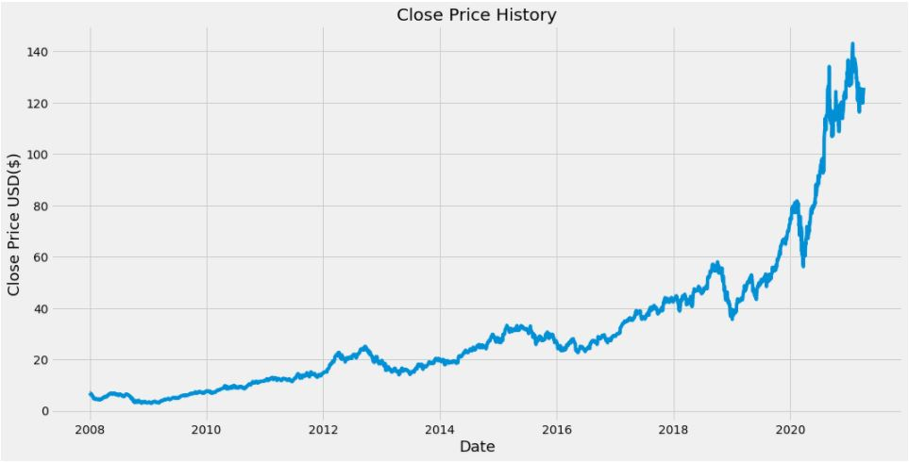
Linear Regression:

Slide 7

LSTM Network

Slide 8
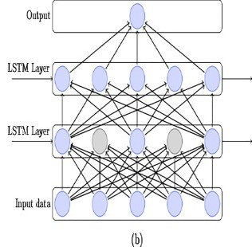

Slide 9
Performance Metrics
RMSE
Root Mean Square Error (RMSE) is the standard deviation of the residuals (prediction errors). Residuals are a measure of how far from the regression line data points are; RMSE is a measure of how spread out these residuals are. In other words, it tells you how concentrated the data is around the line of the best fit.
MAE
Mean absolute error (MAE) measures the average magnitude of the errors in a set of forecasts, without considering their direction. It measures accuracy for continuous variables. The equation is given in the library references.

Slide 10

Thank You

